Slide 1


Bio-waste valorisation in densely populated cities
Webinar on bio-waste and EU policy 27-06-2025
Henning Friege
I

Slide 2
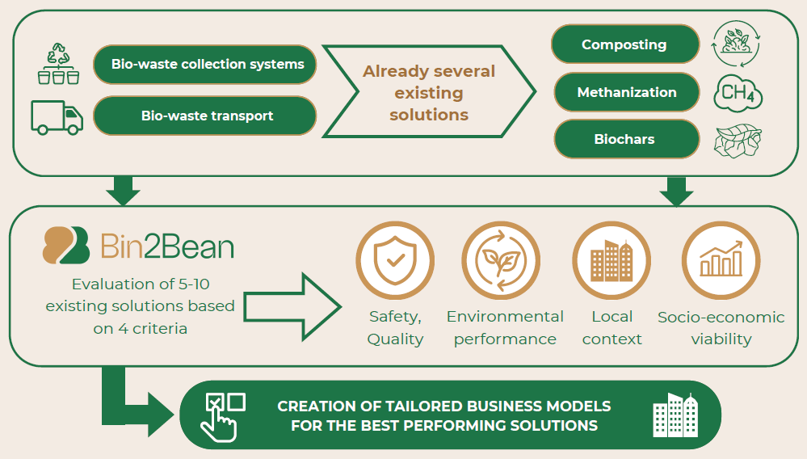
Bin2Bean in a nutshell: 3 Living Labs
Regulatory frame, technical options, state of the art and best practice
-> Optimisation of the processes in the LL‘s -> Business cases
-> Practical implementation should be transferable within the EU
Text – Montserrat 18px

Slide 3
Short characterization of the Living Labs
Data of 2024 | Hamburg | Amsterdam | Aigaleo
No of inhabitants | 1,850,000 | 935,000 | 65,000
Population density | 2,470 inh / km² | 3,830 inh / km² | 10,000 inh /km2
Collected bio-waste from households | 73,800 t | 5,100 t | < 100 t
Collection area | Complete city (collection introduced > 30 years ago) | Several suitable districts | Pilot area, restaurannts, schools
Collection method | Door-to-door, underground containers | Door-to-door, underground containers, bring system | Containers at the kerbsite
Processing | Digestion + composting | Digestion + composting + decentral processing | Composting
Use of soil improvers | Sold to farmers and private households | Agriculture (if feasible), community gardens | Private housholds, school gardens
Text – Montserrat 18px
Quality of bio-waste = f (1 / population density)

Slide 4
Regulatory frame for Hamburg
Regulations at European level
WFD Art. 11 (2): Recycling target 55% of municipal waste until 2025; Art. 22 (1): Separation of bio-waste (enforced since 2023); Art. 14: Polluter pays principle
FPR Annex I + II: Minimum conditions for soil improvers (PFC 3 A), composts (CMC3), organic fertilisers (CMC4, CMC5)
Regulations at national level
KrWG § 9: Recyclable waste must be separately collected (compulsary for bio-waste ince 2015); § 12: Quality assurance for products made from bio-waste
BioAbfVO: Limit values also for the input of biological processing; facilities are urged to refuse bio-waste with >3% impurities and to inform the authorities in case of continuous contamination; control level for plastics: 1%
Regulations of the City of Hamburg
Bio-waste ordinance: § 3: Citizens must use the bio bins provided by the city; § 4: Exceptions are possible, e.g. in case of home composting
Waste disposal fees: Differentiated charging system depending on the volume of waste; remarkable benefits for bio-waste separation

Slide 5
Stadtreinigung Hamburg (SRH): Current status and goals
Goal for bio-waste collection:
2023: 73,800 t bio-waste (plus about 19,000 t green waste)
2030: 106,890 t organic waste (plus 19,100 t green waste)
Goal for BW quality: < 3% contaminations also in future
Bützberg bio-waste facility:
2023: capacity 60,000 t /yr.
2026: capacity 90,000 t /yr.
Quality of compost / soil improver:
Until now: German quality mark, «can be used for organic farming»
Plus: CE mark (difficult task!)

Slide 6
Stadtreinigung Hamburg: Communication and awareness raising
Present status:
In general: «waste separation pays off!» with regard to climate, resources, charges,..
Convenience: e.g. App for waste mgt., paper bags free of charge for bio-waste
Special information for tenants of large housing complexes, coordination with owners
«Waste training» for children
«Yellow card» in case of spoiled bio-bins; «red card», i.e. extra fees for tipping
Recommendations from the project:
Activate interested citizens as «ambassadors» of compost
Integrate soil health in your communication strategy
Engaging organic farmers as advocates for sustainable organic waste utilization

Slide 7
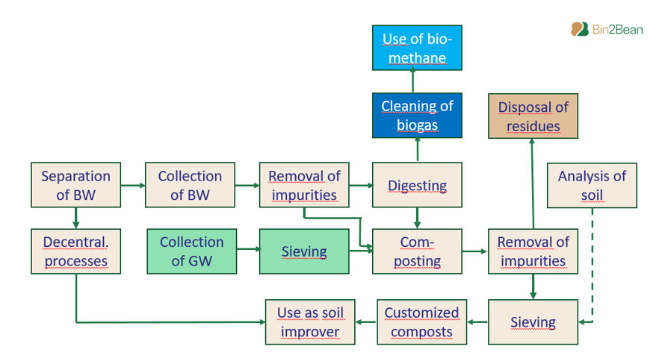
The value chain from bio-waste to soil
Keep an eye on the complete value chain
Contaminations can only partially be removed
Text – Montserrat 18px
Quality of the products is key!

Slide 8
Conclusions from the case of Stadtreinigung Hamburg and questions for the discussion
Regulatory frame:
EU regulations should be enforced in the Member States – what is the best solution?
End-of-waste regulation is discriminating – what should be done?
Differentiated charges should be the norm – how to overcome taxes, flat fees,…? How to identify the polluters?
Communication:
Healthy soils need high-quality compost – how can this be communicated?
Organisation:
Controlling the chain – how can this be set up?

Slide 9
Thank you!
Prof. Dr. Henning Friege
Friege@N-hoch-drei.de

Slide 10
Text – Montserrat 18px

Slide 11
SLIDE TITLE – Montserrat 24px
Delete slide if not necessary

