Slide 1
GrennoMed living lab – recommendations for innovation
HOOP – EU recommendations to foster circular bioeconomy
Cristiano Pisani
CETENMA
27/06/2025

Slide 2



Green
Innovation
Mediterranean
Living Lab

Slide 3

What is the scope of GreennoMed Living Lab (LL)?
Circular fertilisers
Healthy soil
Low-input and regenerative agriculture practices

Slide 4
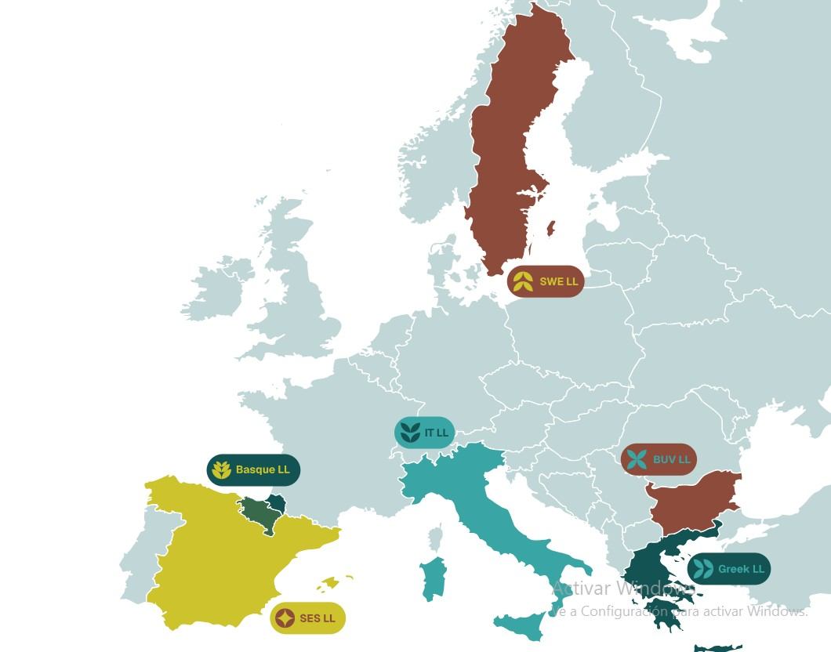
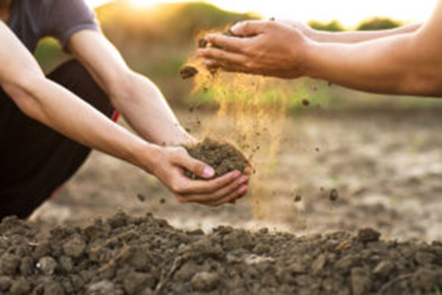
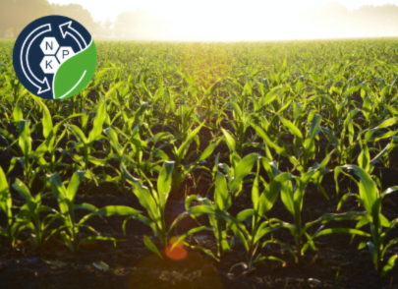
Where is GreennoMed LL and its history
bioSoilution
iCOSHELLs
Future projects

Slide 5
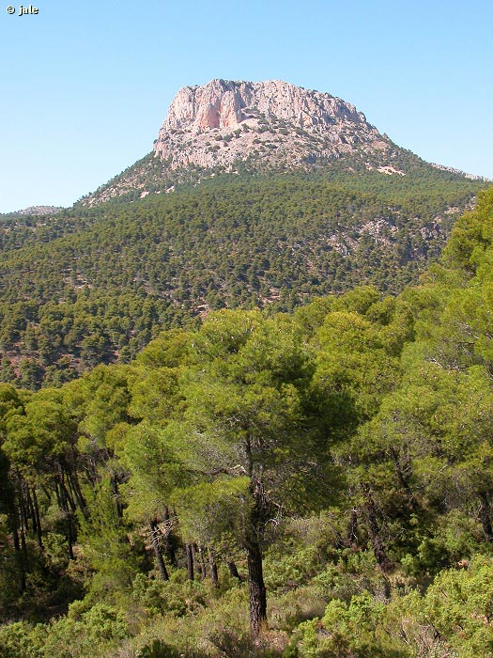
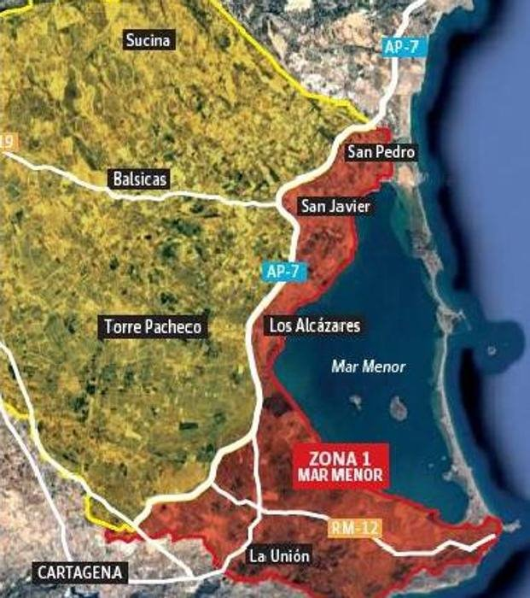
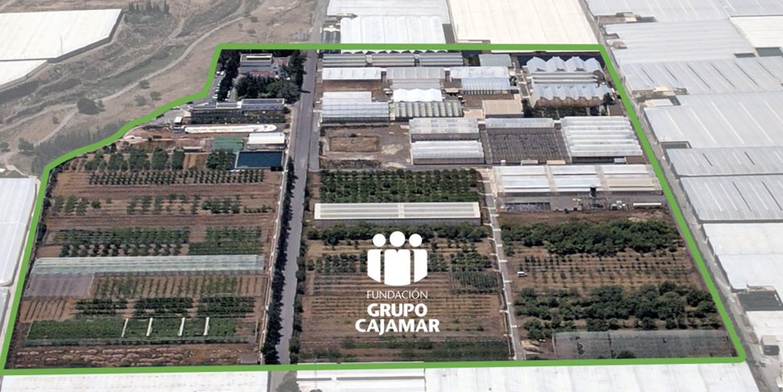
Why do we need a LL to foster innovation in circular fertilisers?
To create a field test network (volunteer farmers)
To co-design the business models
To understand fertiliser application needs
To understand users’ concerns about circular fertilisers
To understand users’ fertilisation needs.

Slide 6
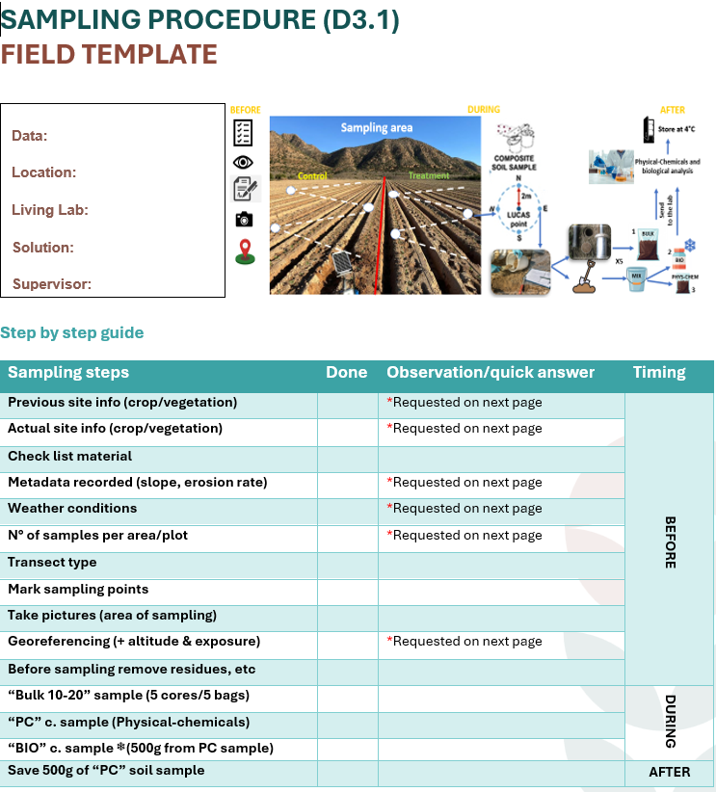
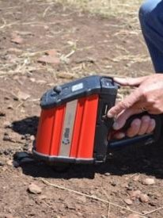
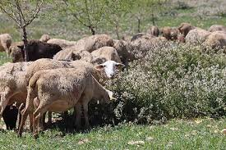
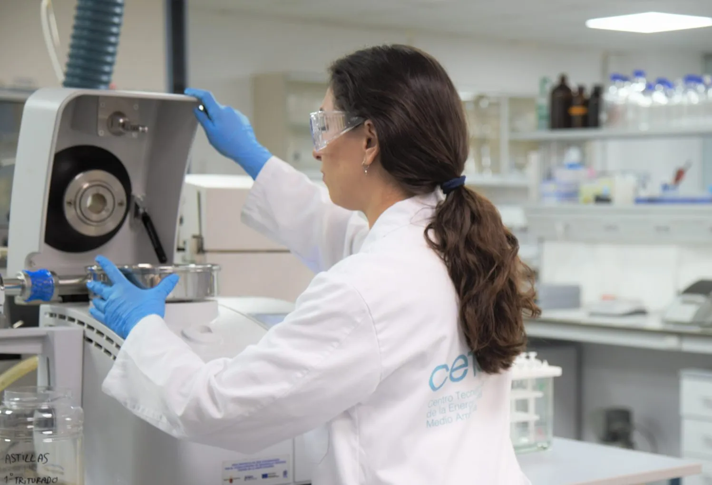
Why is the innovation through a LL more strategic?
Real – life tests/needs
Preliminary exploration
Co-creation of solution and market development
Multiple technical expertise

Slide 7
Recommendations for innovation from GreennoMed
Include technical expertise (agronomists, environmental scientists, circular economy experts) among the operational structure of the LL
Avoid stakeholder fatigue by clustering under the LL various R&D projects
Deliver results and solutions to attract and keep engaged the stakeholders
Schedule 2+ meeting/years for co-creation of the experiments and services
Cascade funding

Slide 8
Recommendations for the development of circular fetilisers (CF) from GreennoMed
Count on sufficient quantity of CF formulations (50-60 kg min.) – pilot scale of both production and testing phases (to gain user’s trustworth)
Co-create the formulations with the stakeholders (add bio-stimulant, liquid or solid?, nutrient content %, etc…)
Pre-evaluate the availability of the biowaste feedstock and its purity.
Take always into account any regulatory barriers at any step of the innovation/co-creation process.

Slide 9

HOOP – Circular Fertilisers
Compost from biowaste
Compost from green waste (no animal by-product)
Biochar from compost refuse (lignocellulosic materials mainly)
Biochar from green waste

Slide 10
HOOP Recommendation for policy uptakes to circular fertiliser uptake

Slide 11
HOOP’s circular fertilisers
Compost from biowaste
Compost from green waste (no animal by-product)
Biochar from compost refuse (lignocellulosic materials mainly)
Biochar from green waste

Slide 12
Stop hindering biochar from biowaste
The revision of Regulation 1069/2009 (Article 5) to establish or permit the establishment of end-point criteria for the production of biochar intended for soil improvement. This is supported by the fact that the pyrolysis operating temperatures required exceed significantly those set for other methods to achieve the end-of-waste status for animal by-products.
The Revision of Industrial Emission Directive 2010/75/EU with regards to the pyrolysis of biowaste of green waste to produce biochar.

Slide 13
End-of-waste status and quality assurance
Establish criteria for the End-of-Waste status for several types of urban biowaste (food waste, garden waste, etc.) to clarify and simplify the end-of-waste procedures.
The Revision of Invasive Alien Species Regulation 1143/2014 with regards to the use of the invasive species.
Promote the implementation of product and process quality assurance schemes in all Member States to support the promotion of bio-waste derived fertilisers while ensuring safety and functionality.

Slide 14
In general:
Revising key regulations and regulatory frameworks
Promoting innovation and investment, by expanding funding for innovation procurement (pre-commercial public procurement and public procurement of innovation) and by ensuring that the EU Taxonomy allows flexibility for high-performing, innovative technologies not explicitly listed.
Read the full recommendations here!

Slide 15
Cristiano Pisani
CETENMA
Cristiano.pisani@cetenma.es

