Slide 1
Overview of biowaste management in Europe
Aline Granjard
Policy Officer at ECN
27 June 2025

Slide 2
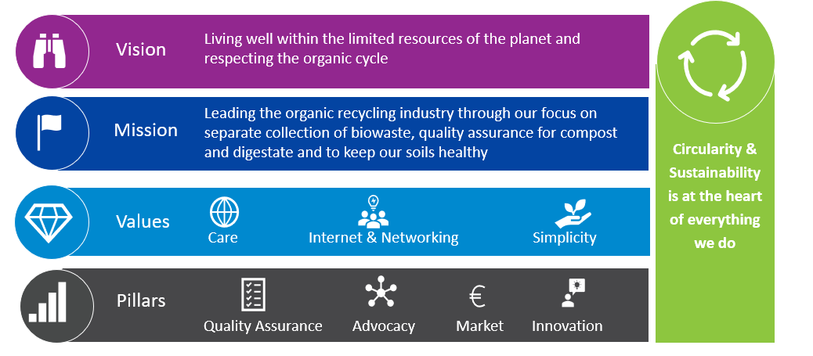
European Compost Network - ECN
67 Members from 27 European countries
> 4.500
Composting & Anaerobic Digestion Plants
≈ 48 M tpa
Treatment Capacity

Slide 3
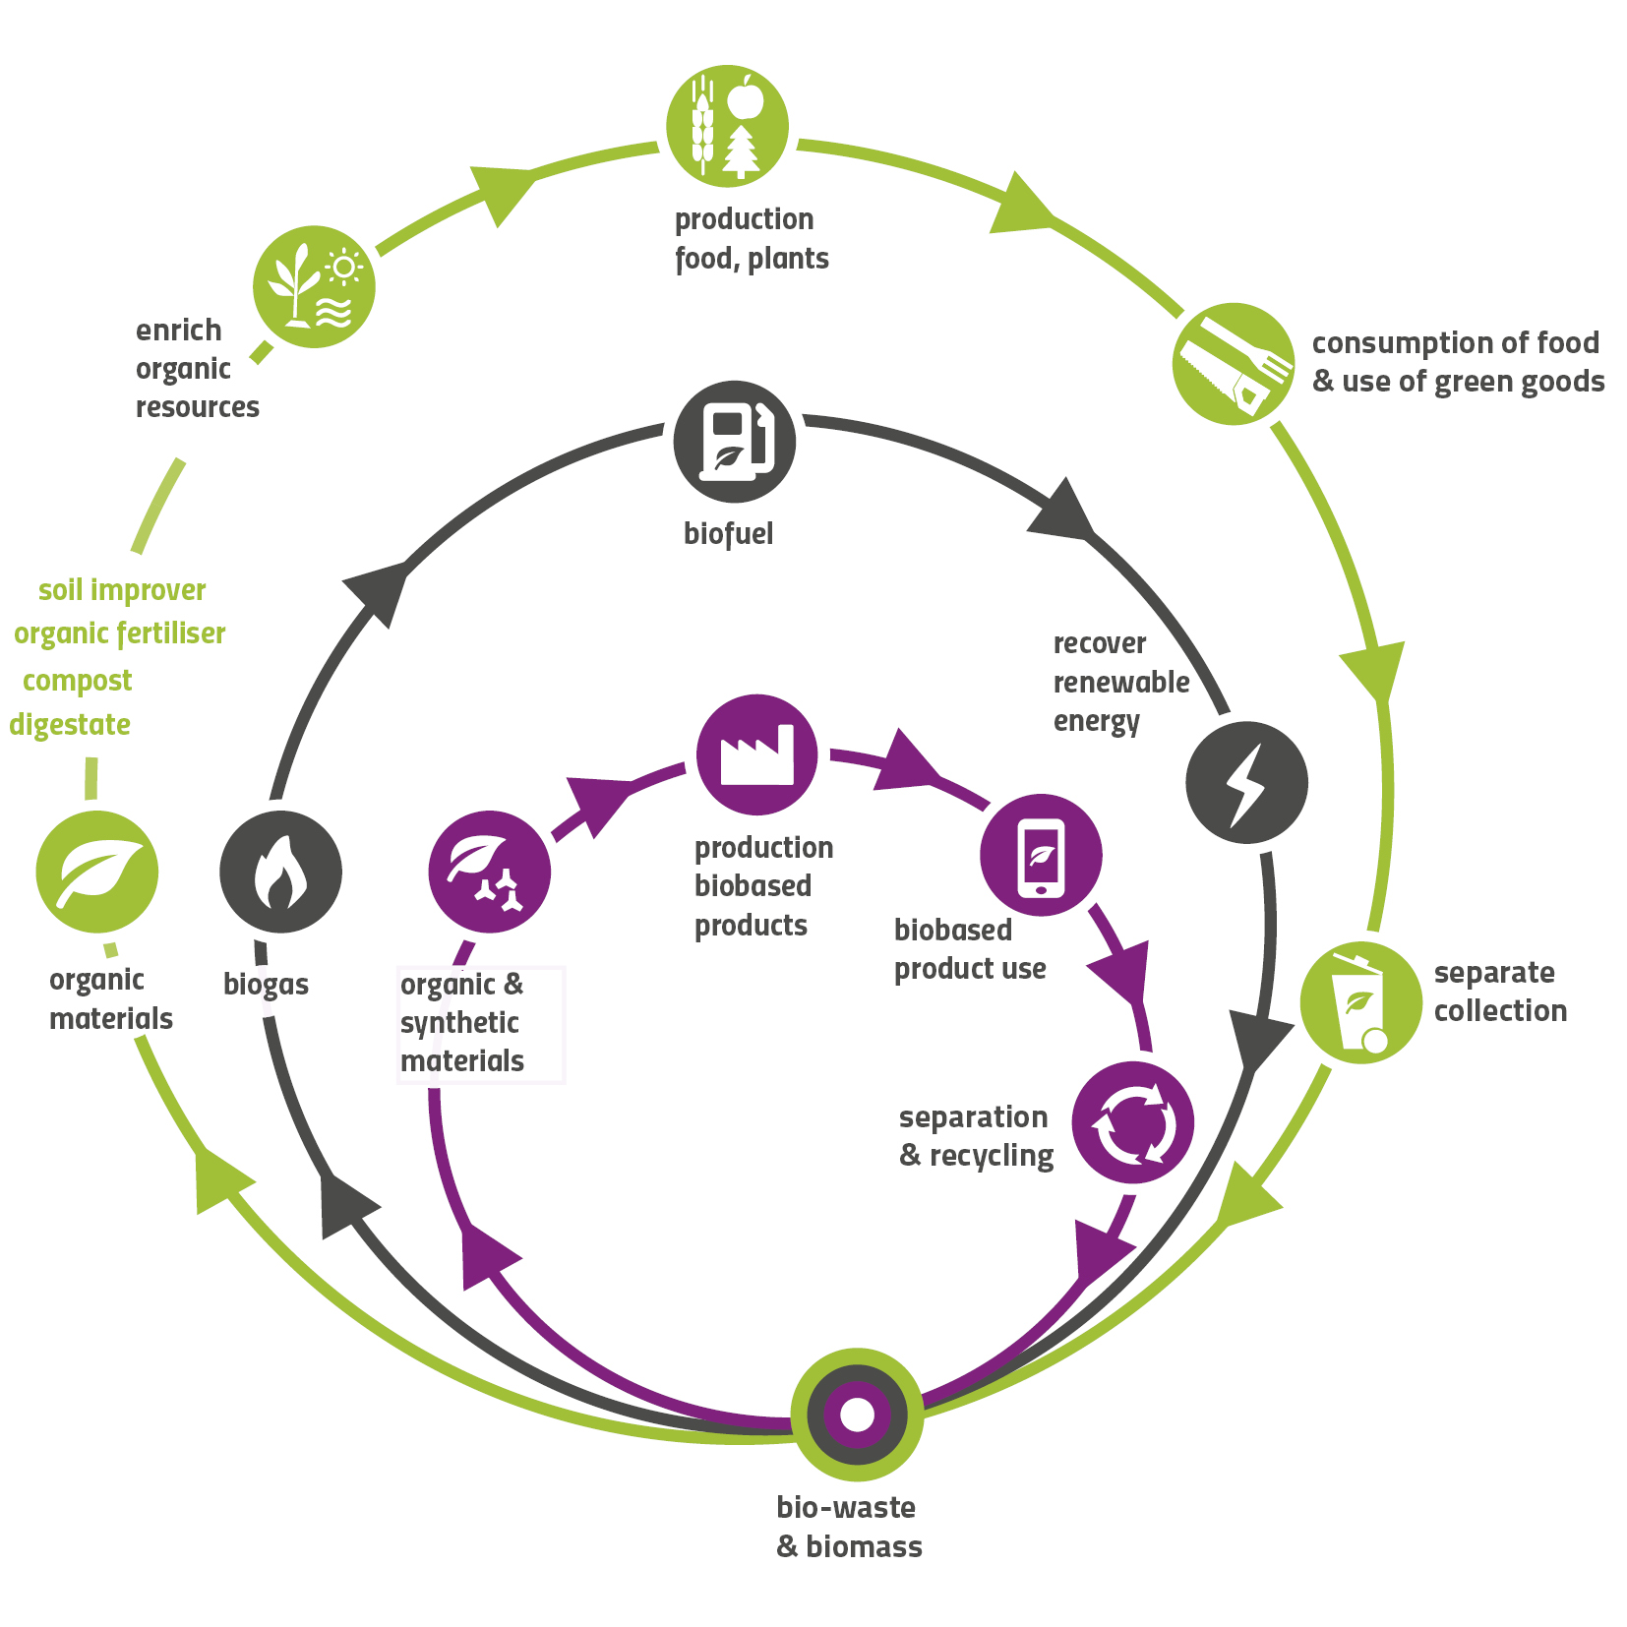
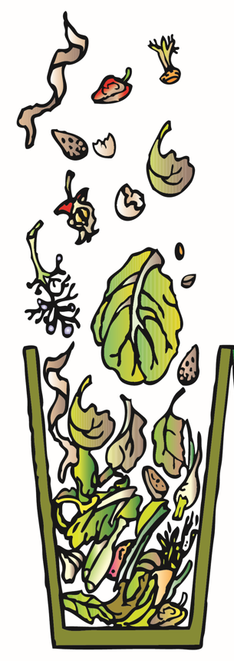
Biowaste in the circular bioeconomy
A Cross-Cutting Resource
Biowaste
European Green Deal
Circular Economy Act
Bioeconomy Strategy
Waste Framework Directive
Fertilising Products Regulation

Slide 4
Biowaste management – Legal framework
WASTE FRAMEWORK DIRECTIVE
Bio-waste means biodegradable garden and park waste, food and kitchen waste from households, offices, restaurants, wholesale, canteens, caterers and retail premises and comparable waste from food processing plants
Recycling of 65% of municipal solid waste by 2035
Landfilling of max 10% of municipal solid waste by 2035
Mandatory separate collection of biowaste since 1st January 2024

Slide 5


Biowaste treatment and input
Input for compost and digestate production
Recycling Processes for Biowaste
Composting
Anaerobic Digestion
Composting
Green waste
Garden and 76% food waste
41%
Green waste (separately collected)
1%
Anaerobic Digestion
18%
Food waste (separately collected)
37%
Composting
Anaerobic digestion +
Composting
35%
Garden & food waste (co-collected)
7%
2%
Food & drink processing waste (C&I)
19%
Anaerobic Digestion
Food waste
Other
Anaerobic digestate
73%
1%
0%
2%
Other (separately collected)
36%

Slide 6
Biowaste recycling into fertilising products – Legal framework
CE mark:
free trade on the common market
Quality requirements
Conformity assessment
End-of-Waste criteria
FERTILISING PRODUCTS REGULATION
List of End-of-Waste criteria.
Optional.
Environmental and health requirements: limit values for physical and chemical contaminants.
For compost and digestate: specific criteria for impurities (glass, metals, plastics).
Process requirements: time, temperature…
Inclusion of recycled organic fertilisers and soil improvers (e.g., compost and digestate derived from biowaste)
Specific conformity assessment procedure applies when the product is placed on the market.
Market access still needs to be improved.

Slide 7
Compost & digestate production
71 M tpa
BIO-WASTE RECYCLED
21 M tpa
COMPOST PRODUCED
Surface area (million ha) | Fraction of Arable Land | Fraction of Mod./ Severely Eroded Land
2.1 | 2% | 16%
ESTIMATION FOR 2035
46 M tpa
COMPOST PRODUCED

Slide 8

EU Horizon FertiCovery project:
‘Best available techniques to recover or recycle fertilizing products from secondary raw materials’
  Duration: from 1 January 2025 to 31 December 2027 – 3 years
  Goals:
    Analyse best available technologies (BATs) for recycling fertilisers from secondary raw materials
    Advise policymakers and stakeholders on alternative fertilizing products, ensuring balanced nitrogen and phosphorus flows and promoting soil health and structure within ecological limits at regional and local levels.
  Expected outcomes:
    Description of ≥75 technologies (type of feedstock, type of technology and type of products).
    In-depth analysis of 25 technologies and their products (composition, applications, environmental impacts).
    Identification of the 15 best available technologies (factsheets).
    Recommendations to policy makers and practitioners.

Slide 9
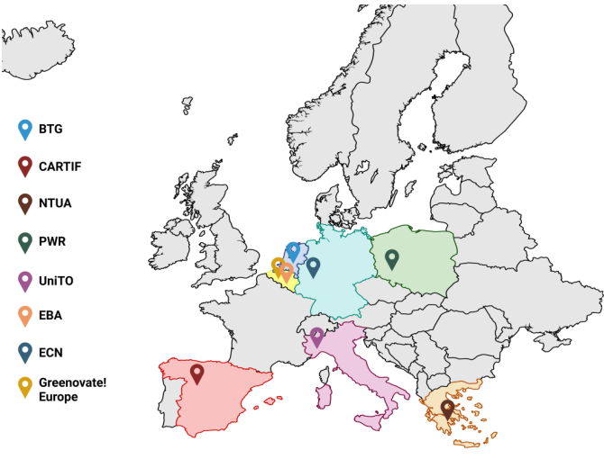


Project partners:
Contact:
Coordinator: Martijn Vis
BTG Biomass Technology Group B.V
vis@btgworld.com
@ Website: https://ferticovery.eu/
Follow us on LinkedIn:
  Official LinkedIn Page: https://www.linkedin.com/company/ferticovery-project/
  Official LinkedIn Group: https://www.linkedin.com/groups/13141483/
BTG Biomass Technology
CARTIF Technology Centre
NTUA - National Technical University of Athens
UniTO - University of Turin
PWR - Wrocław University of Science and Technology
EBA - European Biogas Association
ECN - European Compost Network
Greenovate ! Europe

